Slide 2
Using .NET and Azure to Build & Deploy Microservices Architectures
Aka : Evolutionary Architectures
Alberto Acerbis

Slide 3
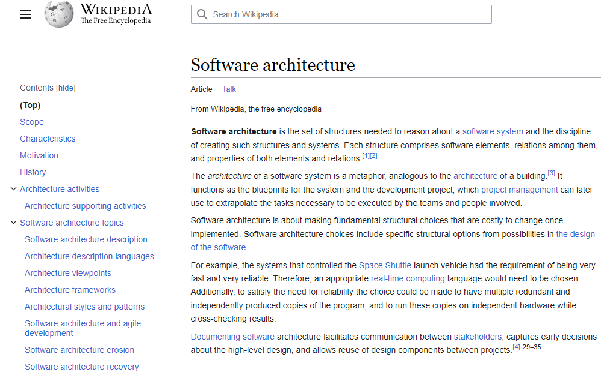
Software Architecture

Slide 4
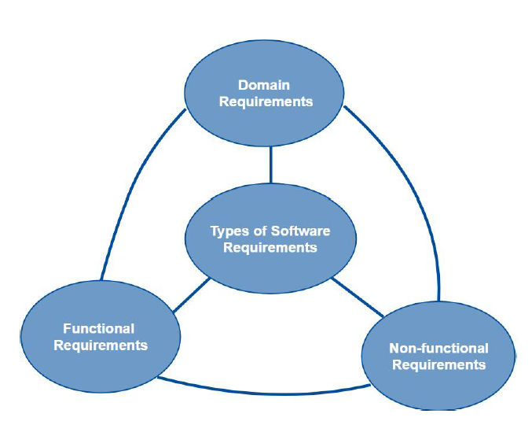
Software Architecture
Functional requirements, aka Business Requirements
Non-functional requirements, aka Technical Requirements
Domain requirements, aka Industry Standard Requirements

Slide 5
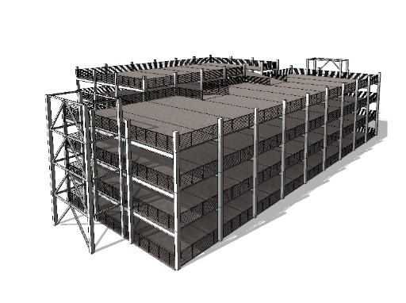
One Upon a Time

Slide 6

The lowest level of knowledge is when we make a lot of decisions about the future system
Microservices
Serverless
Monolithic
SOA
It’s easy to make things complicated, but it’s complicated to make them simple
EDA

Slide 7

Risk comes from not knowing what you are doing
(Warren Buffet)
The only way to decrease ignorance is to increase understanding

Slide 8
New Vision
Regular changes to the requirements have become part of normal business evolution
From architectures as an up-front challenge to a continuous challenge
Changes keep coming so development never ends and the so architecture will keep changing

Slide 9
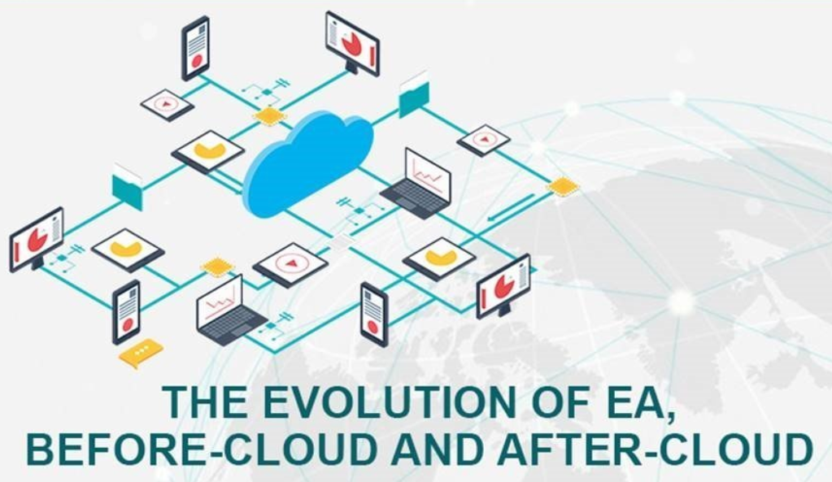
Evolutionary Architecture

Slide 10
Software Rot
Is either a slow deterioration of software quality over time or its diminishing responsiveness that will evenutally lead to software becoming faulty, unusuble, or in need of upgrade.

Slide 11
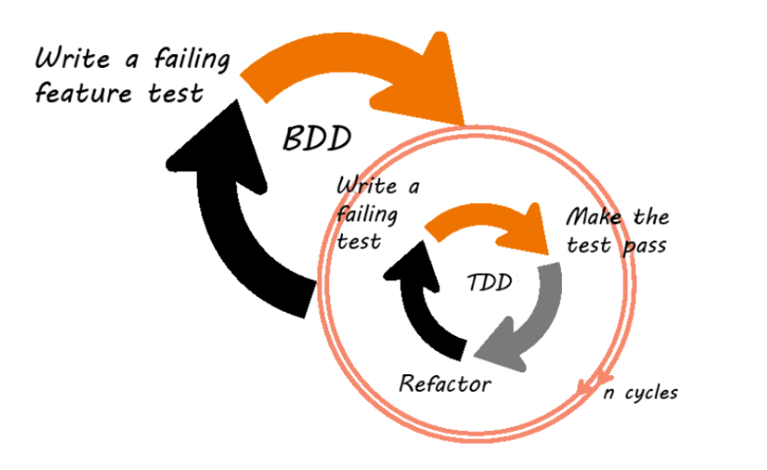
Evolutionary Software

Slide 12
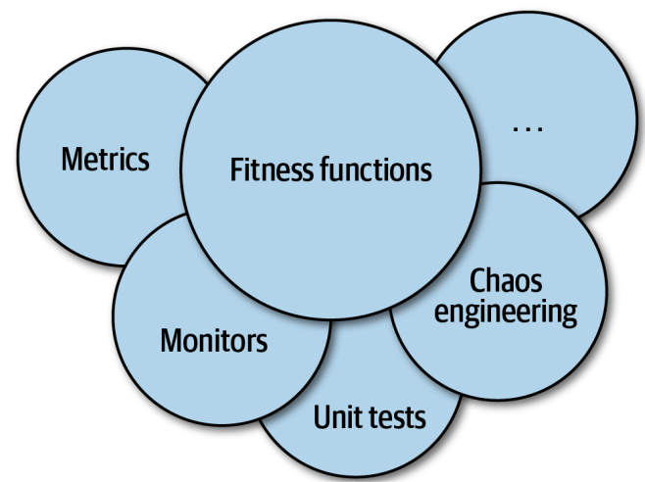

Slide 13


Scenario
Sales
Warehouse

Slide 14
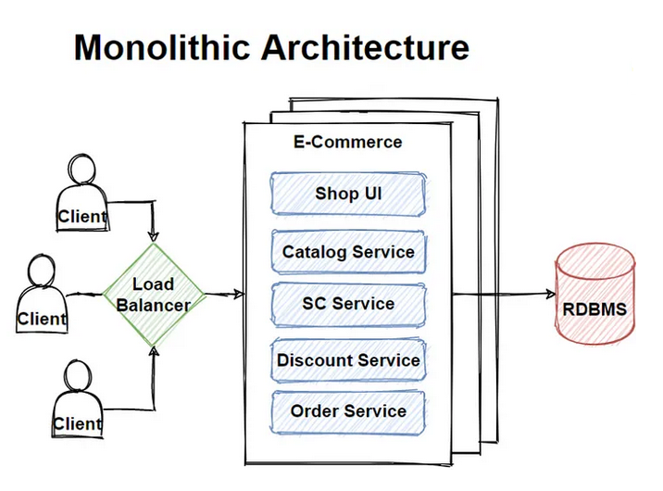
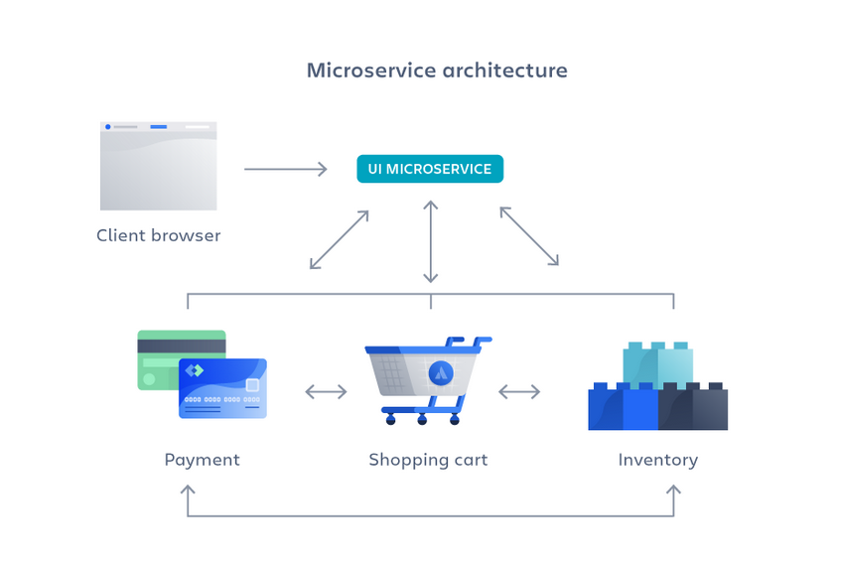
Monolith vs Microservices Architecture

Slide 15
Monolith Advantanges and Microservices Disadvantages
Easy Development
Performance
Simplified testing
Easy debugging
Easy deploy
Development Sprawl
Exponential Infrastructures costs
Added organizational overhead
Debugging challenges
Lack of standardization
Lack of clear ownership

Slide 16
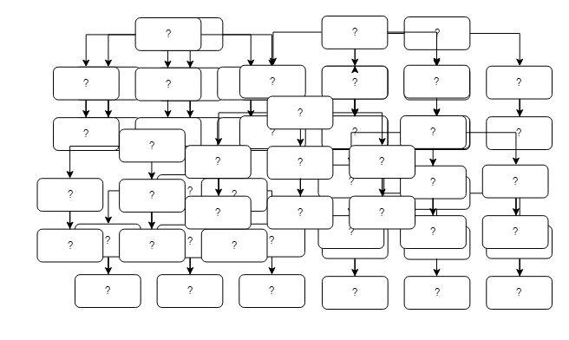
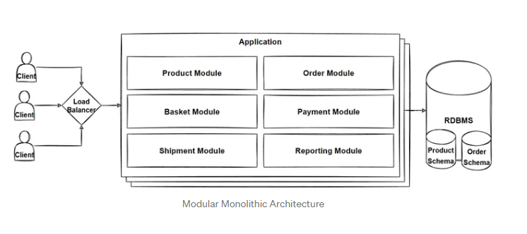
Big Ball of Mud vs Modular Monolithic

Slide 17
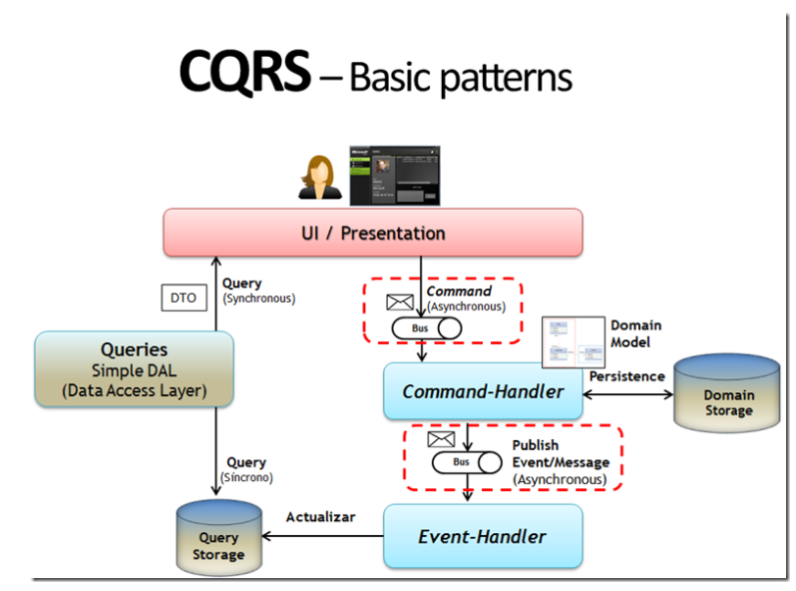
Event-Driven and CQRS Pattern
Microsoft DevBlogs

Slide 18


Slide 19
Azure AppService provides fully managed hosting for web applications including websites and web APIs
AKS
Azure Kubernetes Service (AKS) provides a fully managed Kubernetes option in Azure
App Service
Container App
Azure Container Apps enables you to build serverless services based on containers

Slide 20
Monolith Disadvantanges and Microservices Advantages
Slower development speed
Scalability
Reliability
Barrier to technology adoption
Lack of flexibility
Deployment
Agility
Flexible scaling
Continuous deployment
Highly maintalnable and testable
Independently deployable
Technology flexibility
High reliability

Slide 22


Evolutionary Architecture

Slide 23


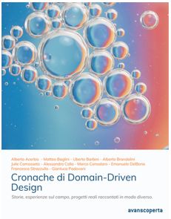






About Me
alberto.acerbis@intre.it
https://github.com/brewup
https://github.com/cqrs-muflone
https://github.com/ace68
https://www.twitch.tv/dddbrewup

